Slide 1
CHAPTER – 9
Red Hat Package Manager

Slide 2
Objectives:
At the end of this module, you would have gained fair knowledge on:
What is a Package
Managing Packages using RPM
Managing Packages using GNORPM

Slide 3
Red Hat Package Manager
RPM is a powerful software configuration manager and is the dominant tool for installing, removing, verifying and updating software packages on Red Hat Linux systems. Red Hat Linux installs tools for using RPM at the command line and using a GUI.
RPM consists of two components: a set pf databases that store information about installed software and the programs that interfaces with the databases. It can work with binary and source packages. Binary packages generally referred to simply as RPMs, contain compiled software ready for installation.
They use the file extension .rpm. Source packages, more often called source RPMs, are uncompiled packages used to create binary RPMs and have a .src.rpm file extension.

Slide 4
The rpm command
Generally a package’s file name will be in the following format.
packagename.version.release.architecure.rpm
Eg: fortune-mod-1.2.1-1-i386.rpm
Red Linux is having and inbuilt command line tool named rpm to administer the software packages. Using rpm command you can do:
Installing packages
Upgrading Packages
Removing Packages
Querying Packages
Verifying Packages

Slide 5
Installing Packages
Basic syntax for installing a RPM is
# rpm -I [options] package
Package is the complete name of the RPM to install and the options refines the installation process. The options are explained below:
-v Be slightly verbose and show some useful information during the installation.
-h Print up to 50 hash marks (#) to illustrate the progress of the installation.
- - force Install the package even if it is already installed, install an older package version, or replaced files already installed.
--nodeps Do not perform dependency check before installing or upgrading a package.
--test Do not install the package or update the database, just identify and display possible conflicts or dependency errors.

Slide 6
Installing Packages
In your installation CD-ROM RPMs are stored under RedHat/RPMS directory. For installing software packages from the Installation CD-ROM do the following steps.
Insert the CD-ROM in the drive.
# mount /dev/cdrom /mnt/cdrom
# cd /mnt/cdrom
# rpm –ivh samba-8.0.1-1.1.rpm
Preparing. . . . ######################################## [ 100% ]
1: samba ######################################## [ 100% ]
The next example shows the error generated by trying to install a package which already installed and how to use - -force to ignore the error.
# rpm –ivh samba-8.0.1-1.1.rpm
Preparing. . . . ########################################
Package samba-8.0.1-1.1 is already installed.
# rpm –ivh --force samba-8.0.1-1.1.rpm
Preparing. . . . ######################################## [ 100% ]
1: samba ######################################## [ 100% ]

Slide 7
Upgrading Packages
The option for upgrading existing RPMs comes in two flavors, -U for upgrade, and –F, for freshen. Upgrade will install the package even if an earlier version is not currently installed, but freshening package installs it only if an earlier version is currently installed.
# rpm -Uvh samba-9.0.1-1.1.rpm
Preparing. . . .#################### [ 100% ]
1: samba ########################### [ 100% ]
# rpm –Fvh samba-9.0.1-1.2.rpm
Preparing. . . .###################### [ 100% ]
1: samba ###################### [ 100% ]

Slide 8
Removing Packages.
Removing or deleting RPMs and their contents is easy. The general form of the command is
rpm -e package name.
Querying Packages
RPM’s query mode is one of its most powerful, useful features. The general form of an RPM query is
rpm -q [ query options]
-q option specifies a query operation and query option specifies what to query, the type of query, how it runs, or the format of its output

Slide 9
If you invoke the query option without any extra options it will give the name of the package if it is installed.
# rpm –q samba smab-8.0.1-1
The –ql option will give a list of files contained in the specified RPM.
# rpm –ql whois
/usr/bin/fwhois
The –qf option will take a file name as its argument and give the package name to which that particular file belongs will be given as the output.
# rpm -qf /usr/bin/find findutils-4.1.6-2

Slide 10
Verifying Packages
Verifying an RPM compares the current status of files installed by an RPM to the file information recorded at the time the RPM was installed, such as file size and MD5 checksum values, and reports any discrepancies. The general form of the verify command is
rpm -V [ package ]
The –V option requests RPM to verify the status of files in package.
# rpm -V whois
# rpm -V fortune-mod

Slide 11
Gnome-RPM
If you do not want to use the command-line version of RPM, you can use Gnome-RPM, a graphical interface for Red Hat Package Manager (RPM).
Gnome-RPM allows users to easily work with RPM technology and features a friendly interface. It is "GNOME-compliant," meaning that it seamlessly integrates into GNOME, a graphical X Window System desktop environment provided with Red Hat Linux.
Using Gnome-RPM, you can easily accomplish the following tasks:
• Install RPM packages
• Uninstall RPM packages
• Upgrade RPM packages
• Find new RPM packages
• Query RPM packages
Verify RPM packages

Slide 12
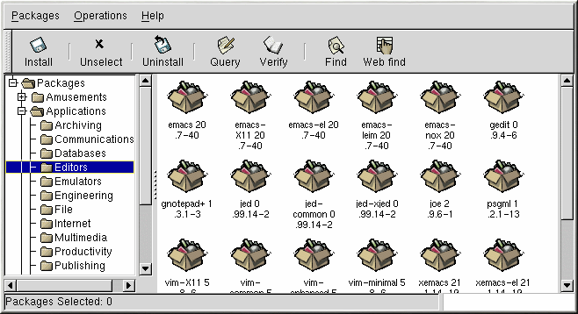
Starting Gnome-RPM
To start Gnome-RPM, use one of the following methods:
• On the GNOME desktop, go to Main Menu Button (on the panel) => Programs => System => GnoRPM
• On the KDE desktop, go to Main Menu Button (on the panel) => System => GnoRPM
• Type gnorpm at a shell prompt.

Slide 13
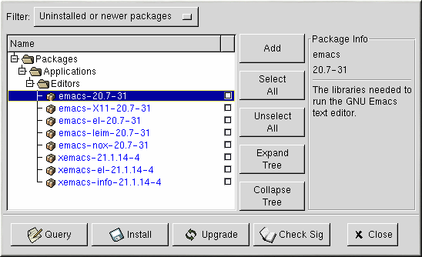
Installing New Packages
To install new packages, choose Install from the toolbar. In the Install window, your view will depend upon what you have selected from the Filter pull-down list on the top of the window. Filter can be used to narrow your choices for viewing packages. Available filters include the following:
• All packages
• All but installed packages
• Only uninstalled packages
• Only newer packages
• Uninstalled or newer packages

Slide 14
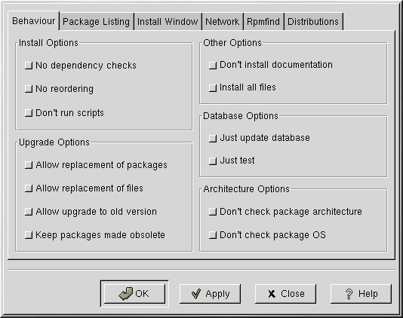
Configuration

Slide 15
Uninstalling Packages
Uninstalling a package removes the application and associated files from your machine. When a package is uninstalled, any files it uses that are not needed by other packages on your system are also removed. Configuration files that have been modified are copied to <filename>.rpmsave so you can reuse them later.
If uninstalling a package would break "dependencies" (which could interfere with the operation of applications that require one or more of the removed files in the package), a dialog will pop up, asking you to confirm the deletion.

